Slide 1
IBM PROJECT
PROJECT TITLE -Problem statement No.39 – Predictive Maintenance of Industrial Machinery
Presented By:
Student Name- Chaitrali Babaso Kamble.
College Name- MIT Academy of Engineering.
Department- Computer Engineering.

Slide 2
OUTLINE
Problem Statement
Proposed System/Solution
System Development Approach
Algorithm & Deployment
Result (Output Image)
Conclusion
Future Scope
References

Slide 3
Problem Statement
Industrial machines are prone to unexpected failures such as tool wear, heat dissipation issues, and power failures. These failures cause unplanned downtime, leading to production delays and increased maintenance costs. Traditional maintenance schedules are reactive or time-based, lacking real-time failure prediction capabilities. There is a need to predict failures before they occur using sensor data and machine learning to enable proactive maintenance.

Slide 4
Proposed Solution
The solution to the problem of unexpected machine failures is a Machine Learning-based predictive maintenance model built and deployed using IBM Watson.ai Studio. Objective of the Solution:-
Goal: Predict machine failure type in advance to enable preventive actions.
Outcome: Reduce unplanned downtime, optimize maintenance schedules, and lower operational costs. Below is the step-by-step explanation
1) Data Collection: Utilize Kaggle’s predictive maintenance dataset containing real sensor data from machines.
Features include: Air temperature, process temperature , Rotational speed, torque ,Tool wear time , Machine type and quality metrics. This data acts as input for the predictive model.
2) Data Preprocessing : Data cleaning to remove missing and duplicate entries.
Detect outliers that may affect predictions.
Normalize features for consistent model training.
Feature selection to identify variables influencing failures most strongly.

Slide 5
Proposed Solution
3)Model Development in Watson.ai Studio: Use Watson.ai Studio’s environment for uploading and preparing data.
Configure AutoAI pipelines to automatically select the best performing algorithm based on the dataset.
Train the model to classify machine conditions: Tool wear failure ,Heat dissipation failure , Power failure , Normal condition (no failure).
4)Deployment on Watson.ai Studio: Deploy the trained model directly as a web service API from Watson.ai Studio.
5)Real-Time Prediction Process: Live machine sensor data is sent to the deployed Watson.ai Studio API endpoint.
The model returns a predicted failure category with associated probabilities. Alerts and recommendations are triggered automatically to maintenance teams.
6) Benefits of the Solution: Proactive Maintenance: Early detection of failures using AI predictions.
Cost Efficiency: Minimized downtime and reduced emergency repair costs.
Scalable Solution: Can be applied to multiple factories or machine types with minimal adjustments.

Slide 6
System Approach
The System Approach defines the methodology, resources, and processes followed to develop and deploy the predictive maintenance model.
1)System Requirements: Software: IBM Watson.ai Studio, Python libraries (Pandas, Scikit-learn, Matplotlib), IBM Watson Machine Learning service.
Dataset: Kaggle predictive maintenance dataset with sensor readings.
Cloud Platform: IBM Cloud Lite account for hosting and deployment.
2) Data Flow Architecture: Data Acquisition: Sensor data collected from machines or historical datasets.
Data Storage: Data uploaded to IBM Cloud Object Storage or Watson.ai Studio environment.
Data Preprocessing: Cleaning, transformation, and feature engineering of raw data.
Model Training: AI models developed in Watson.ai Studio using AutoAI.
Model Deployment: Trained model deployed as a REST API service on IBM Watson Machine Learning.
Real-Time Prediction: Live data fed to the deployed model, predicting failure types.
Alert System: Automated notifications sent to maintenance teams for early action.

Slide 7
Algorithm & Deployment
Algorithm and deployment framework ensures a robust, scalable, and automated predictive maintenance system that can efficiently prevent unexpected machinery failures.
Algorithm Selection: Random Forest Classifier for multi-class classification of failure types.
Input Features: Air temperature, process temperature, rotational speed, torque, tool wear time, and quality measures.
Training: Model trained on historical failure data, optimizing accuracy and precision.
Prediction: Real-time sensor data fed into the model to predict failure type.
Deployment: Model deployed on IBM Watson Machine Learning service, accessible via API for integration into factory systems.

Slide 8
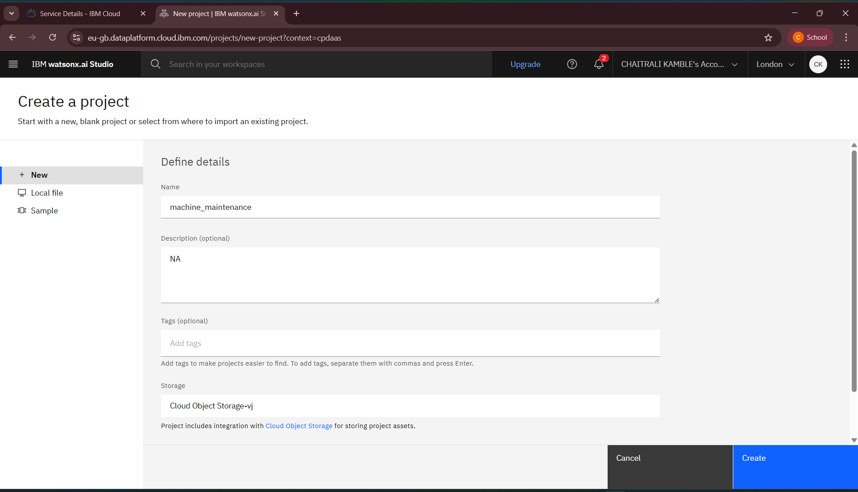
Result

Slide 9
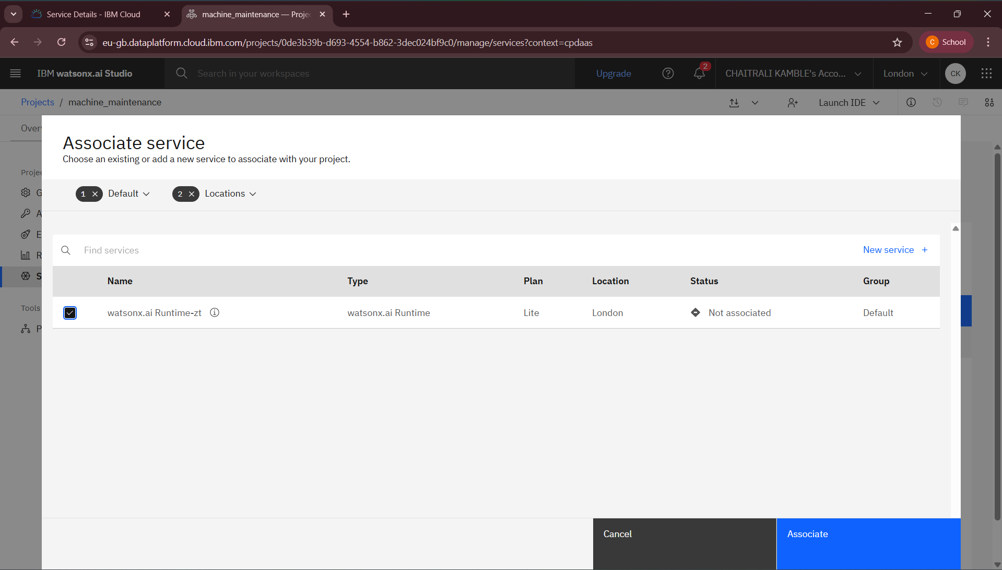

Slide 10
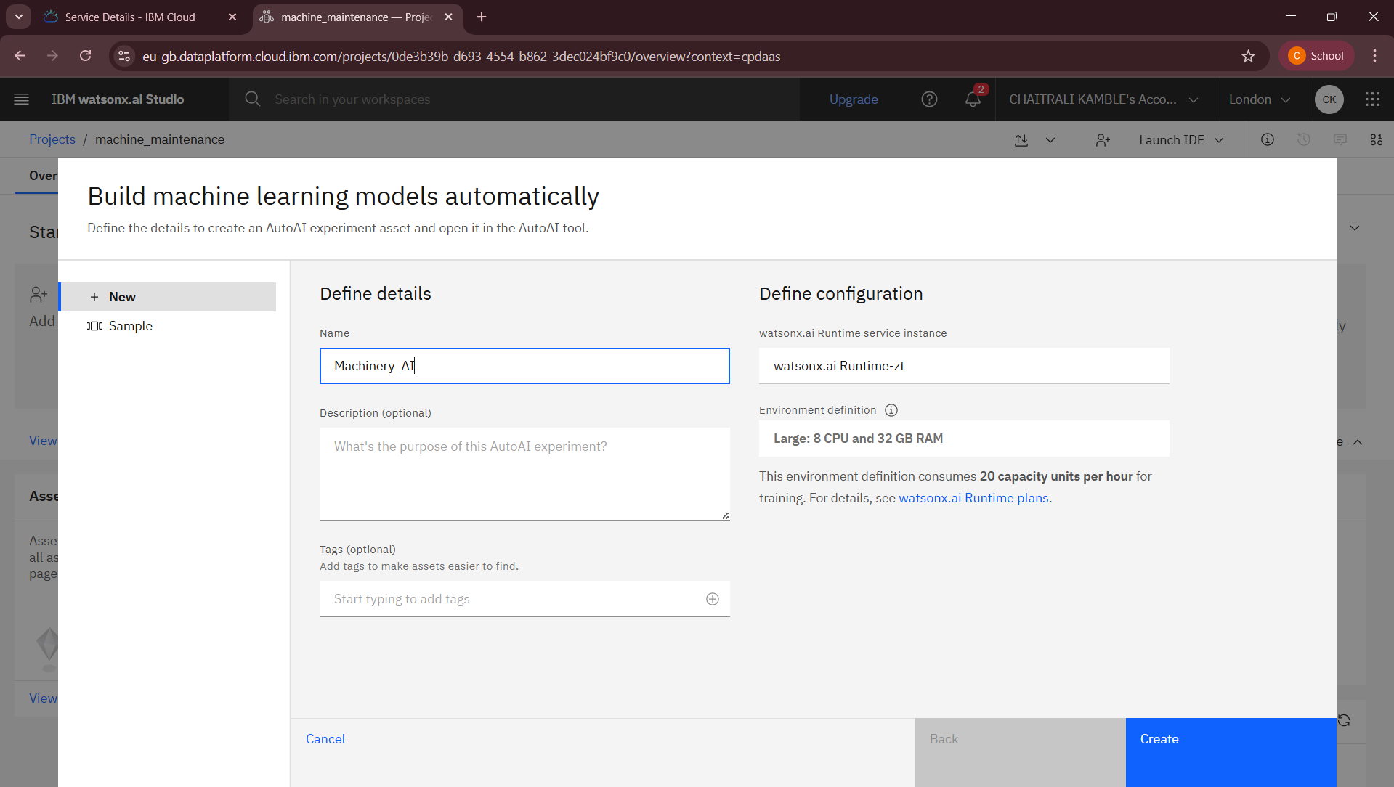

Slide 11
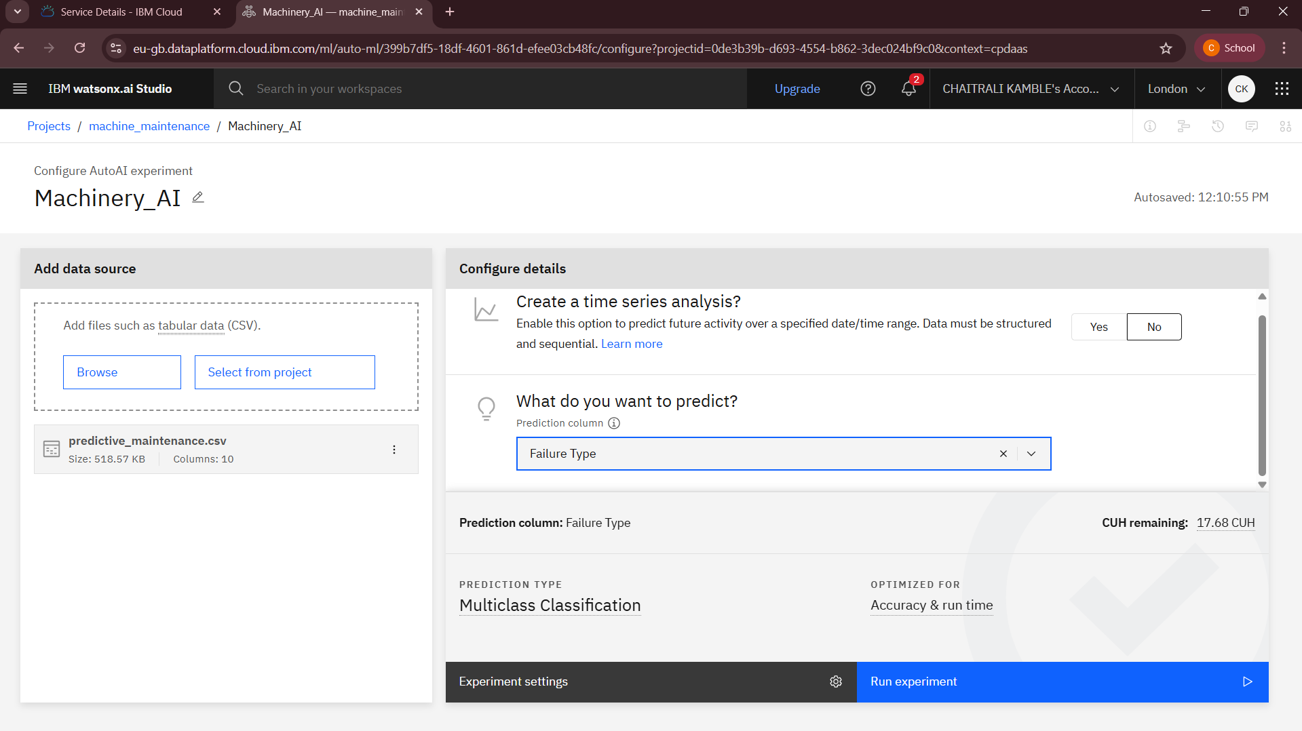

Slide 12
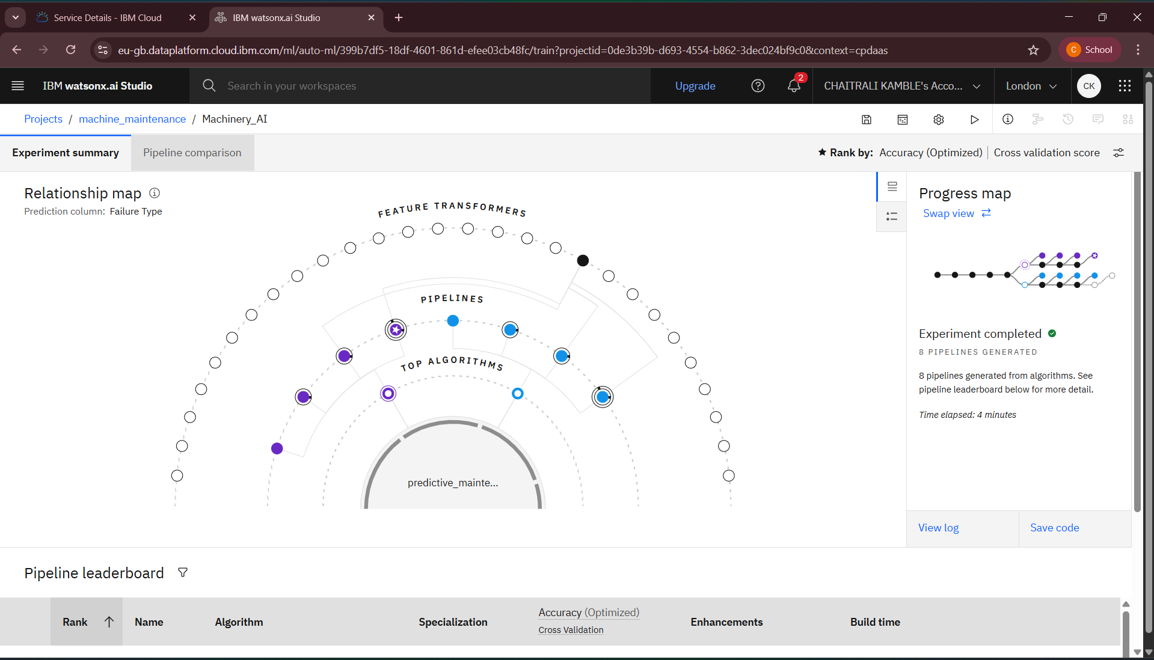

Slide 13
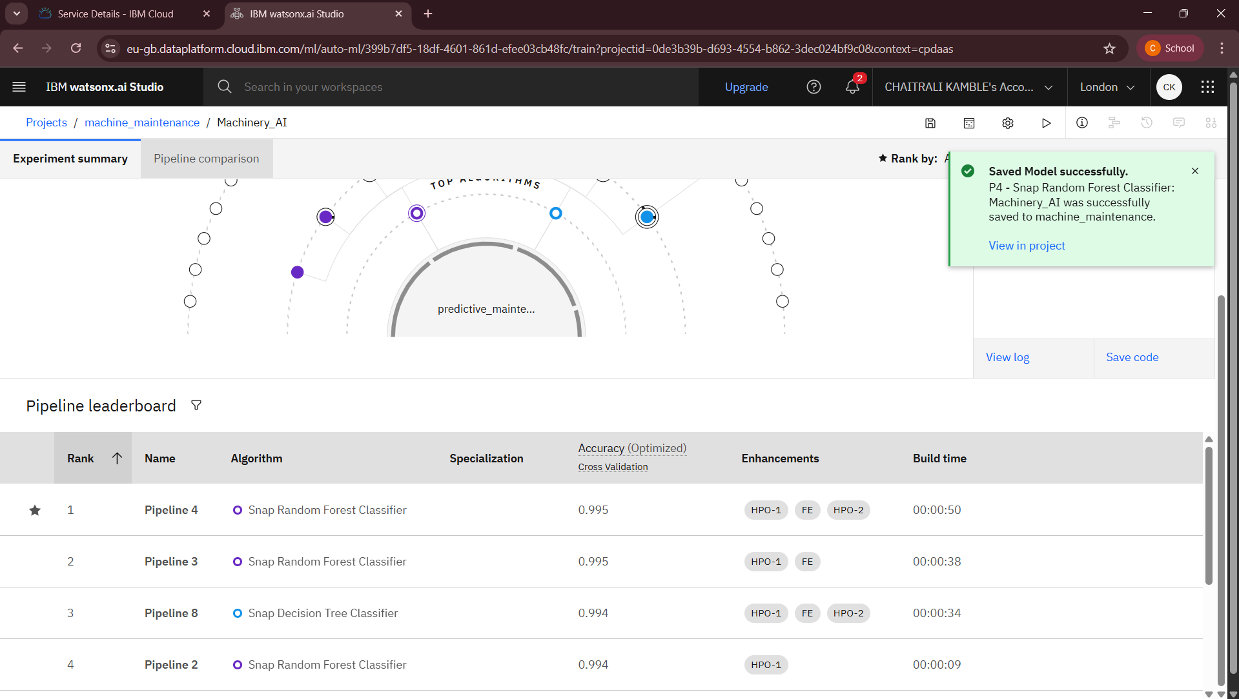

Slide 14
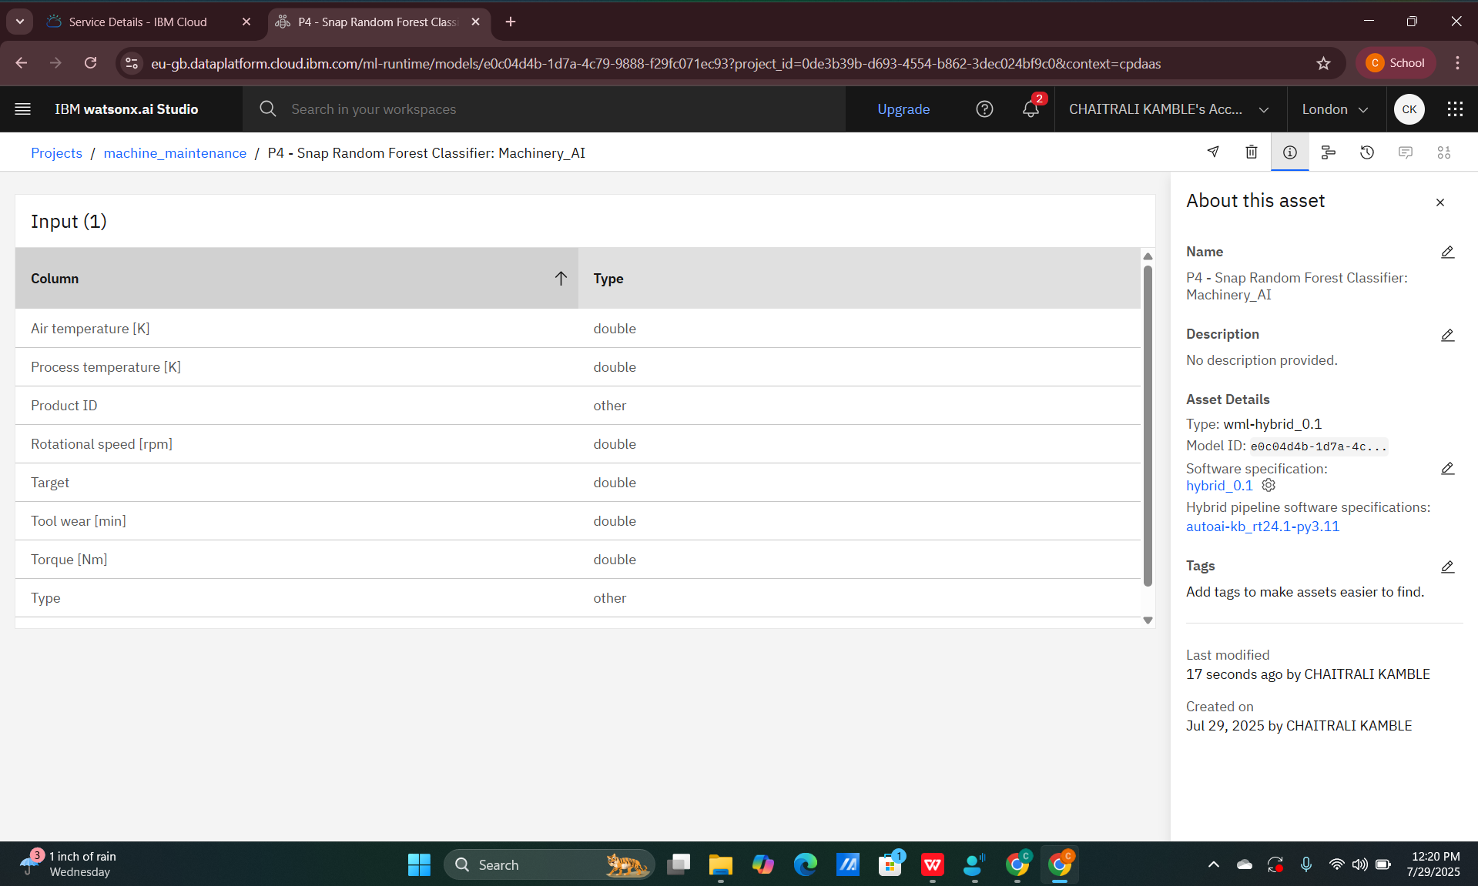

Slide 15
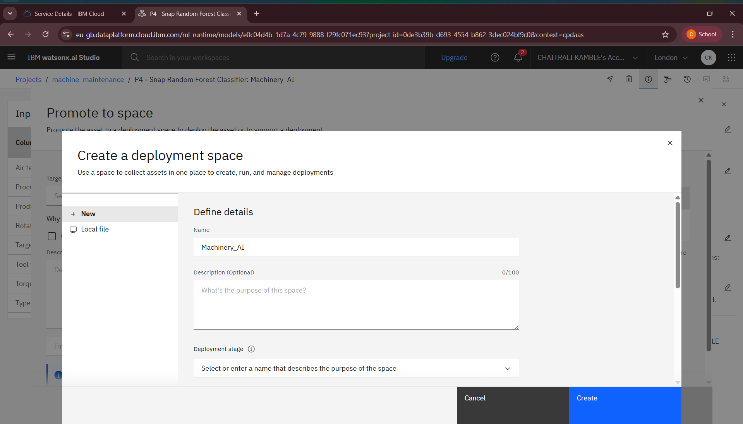

Slide 16
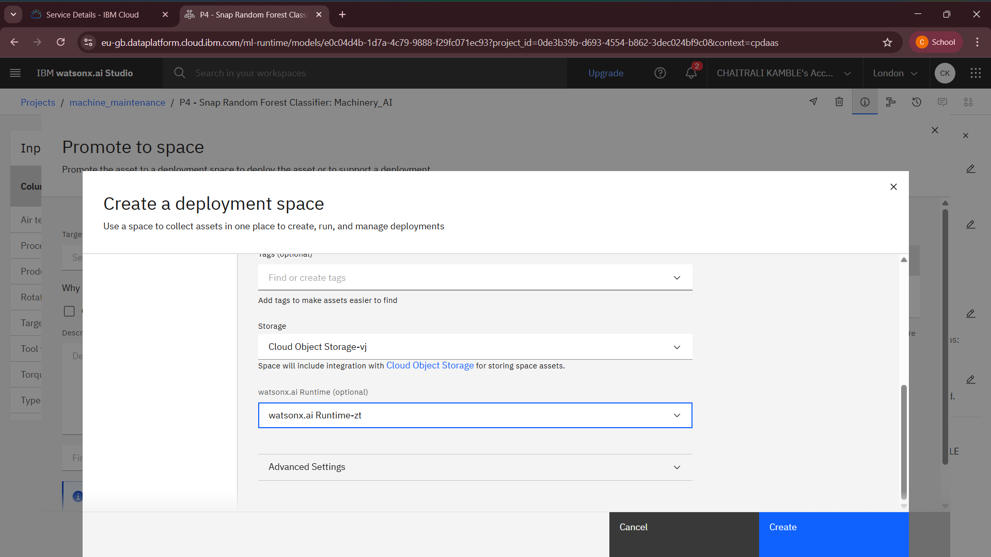

Slide 17
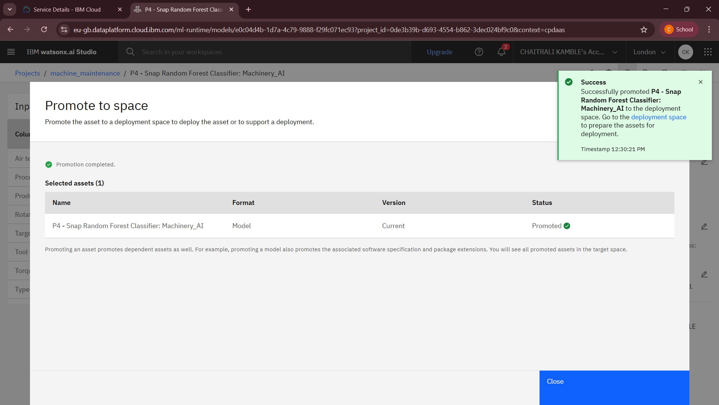

Slide 18
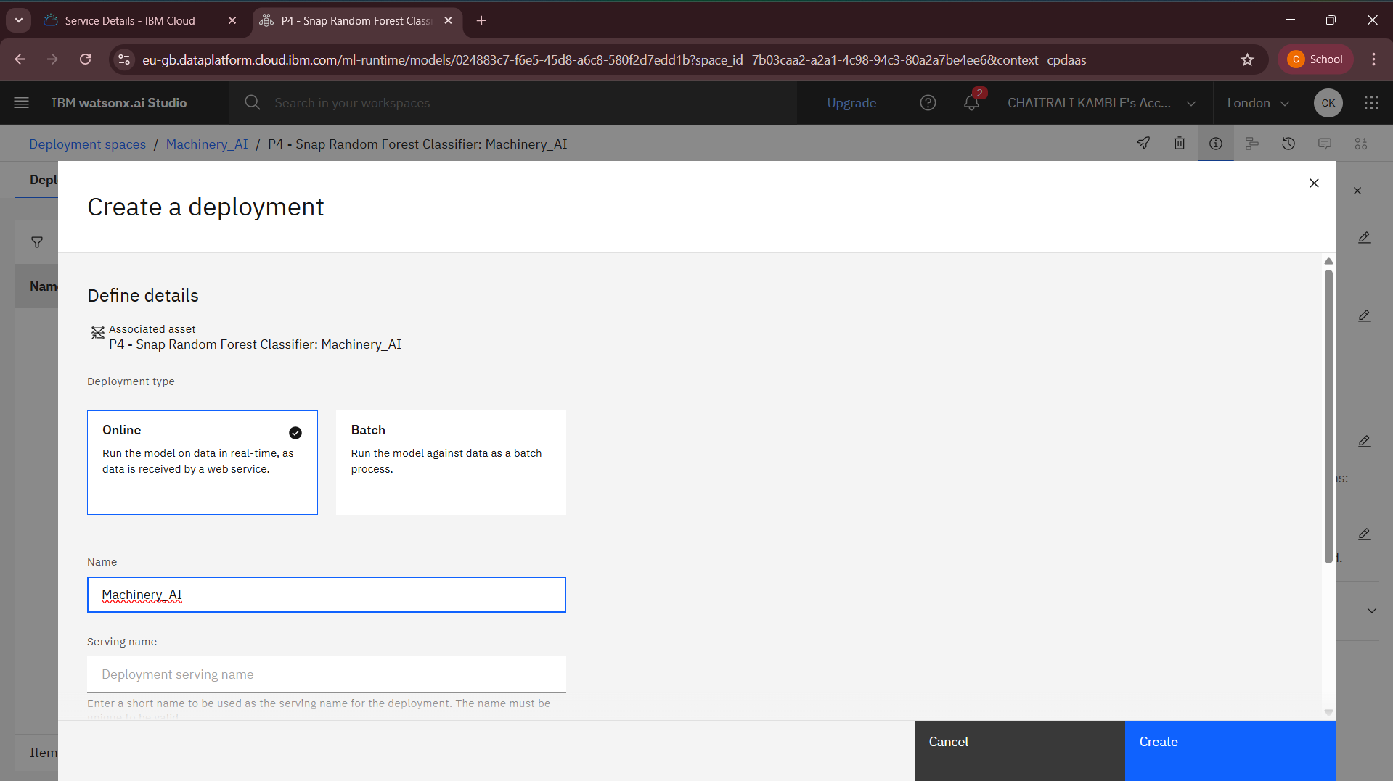

Slide 19
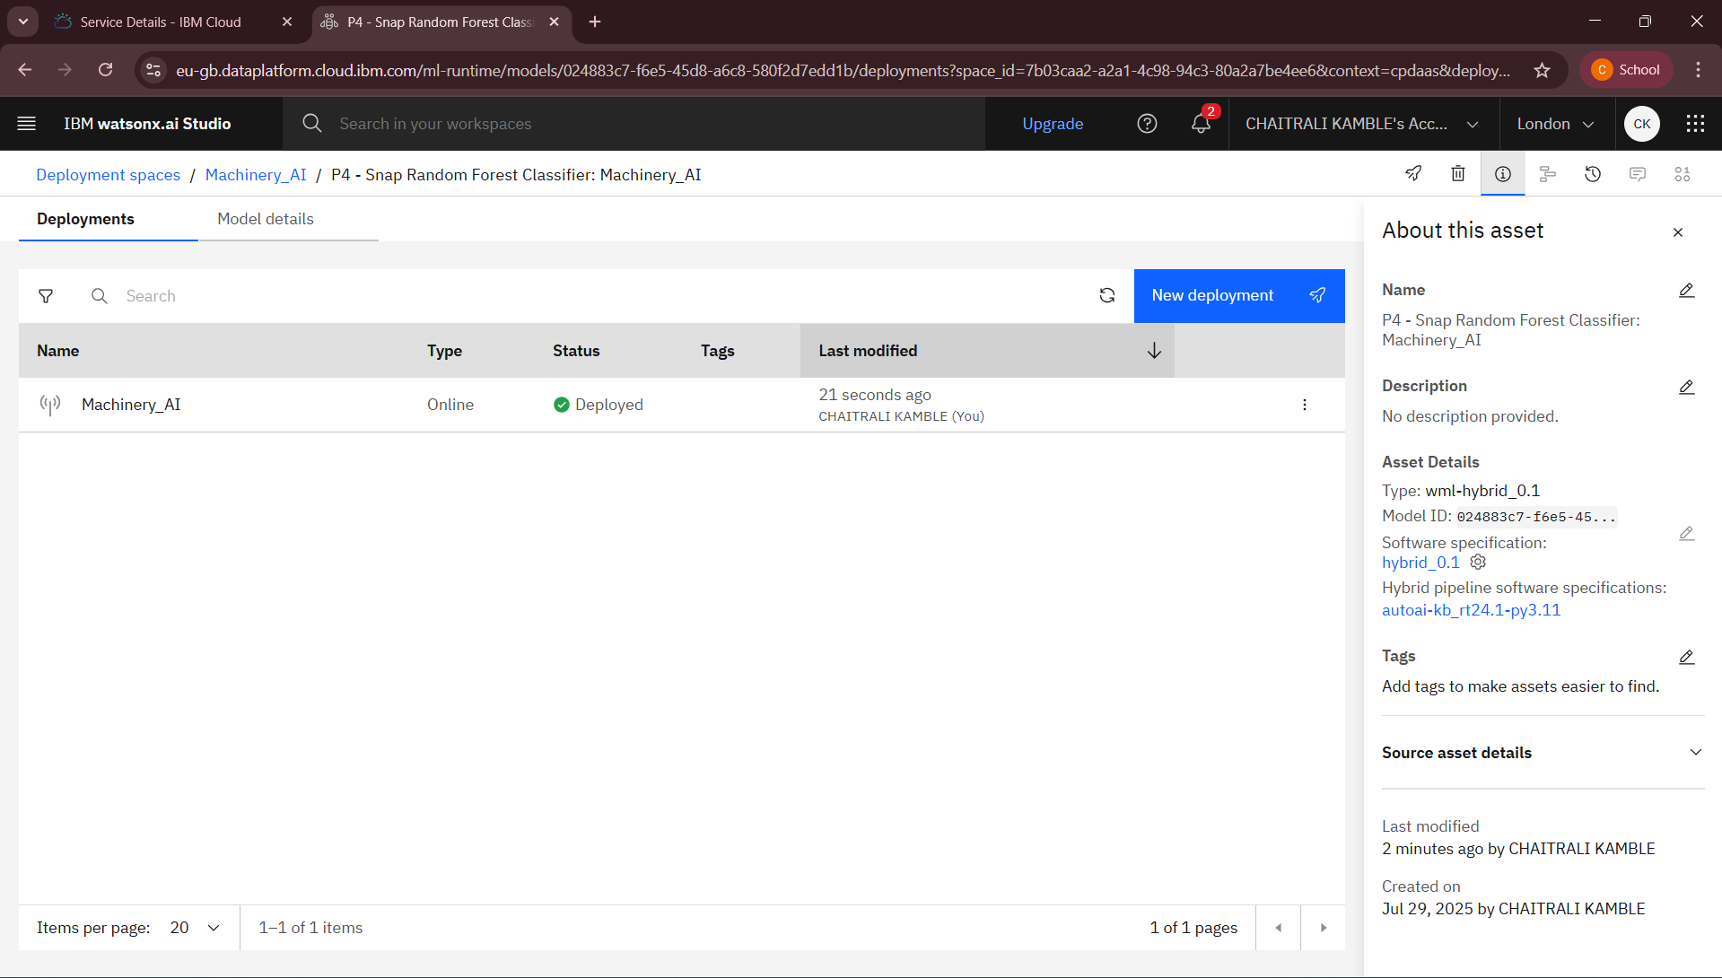

Slide 20
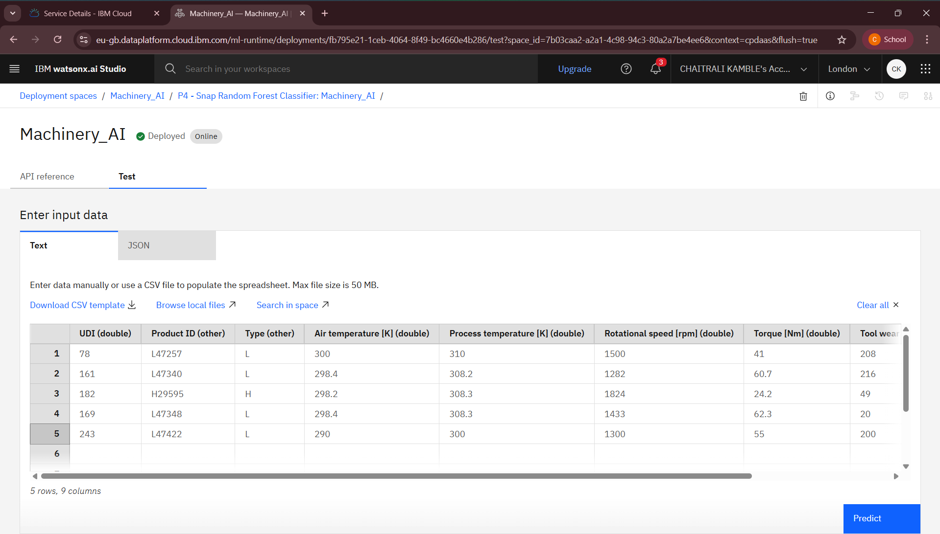

Slide 21
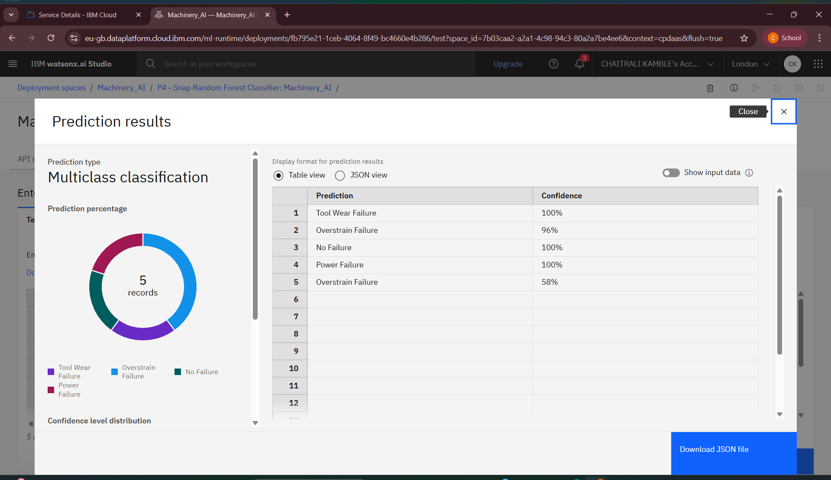

Slide 22
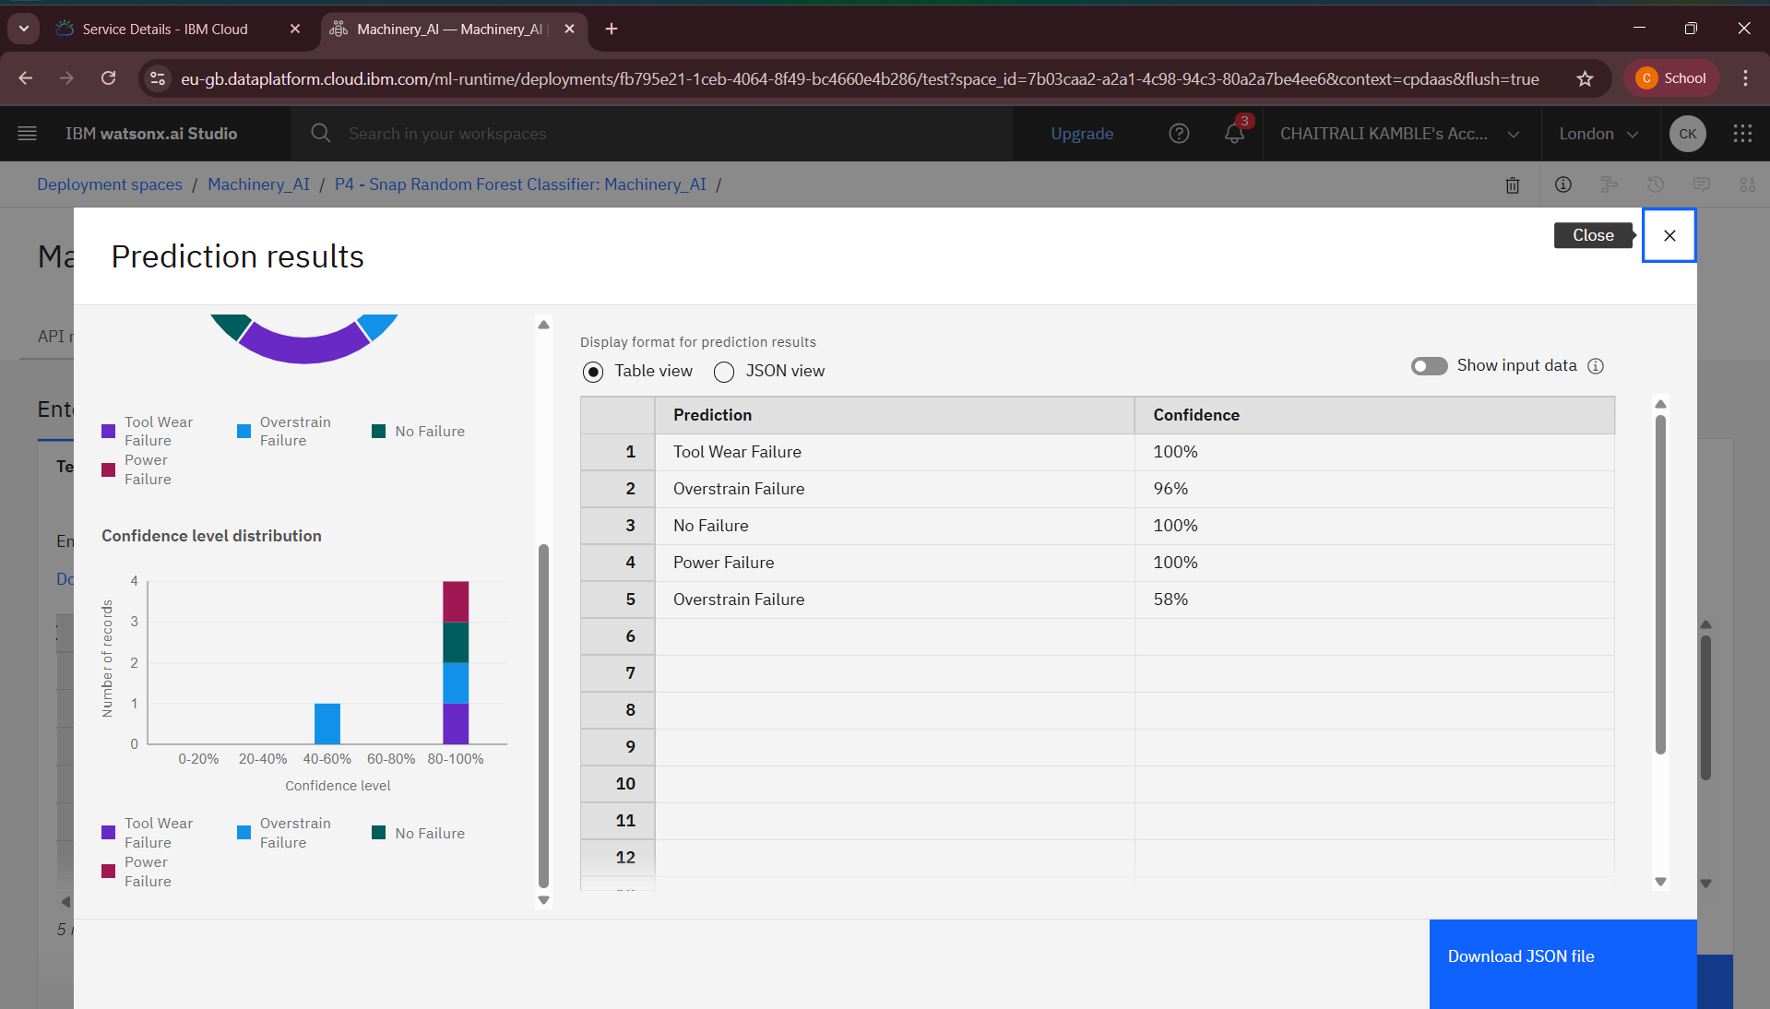

Slide 23
Conclusion
Predictive maintenance models are essential for minimizing unexpected machine breakdowns .
Use of machine learning and IBM Cloud services ensures scalability and real-time analysis.
Reduces operational costs, increases machine lifespan, and improves production efficiency.

Slide 24
Future scope
Integration with IoT sensors for real-time data streaming.
Use of Deep Learning models for more accurate failure prediction.
Expansion to multiple industrial sectors like manufacturing, automotive, aerospace.

Slide 25
References
Kaggle Dataset – Machine Predictive Maintenance Classification: https://www.kaggle.com/datasets/shivamb/machinepredictive-maintenance-classification
Watsonx.ai.Studio Service of IBM Cloud Lite.
Python libraries – Scikit-learn, Pandas, Matplotlib, Seaborn.

Slide 26
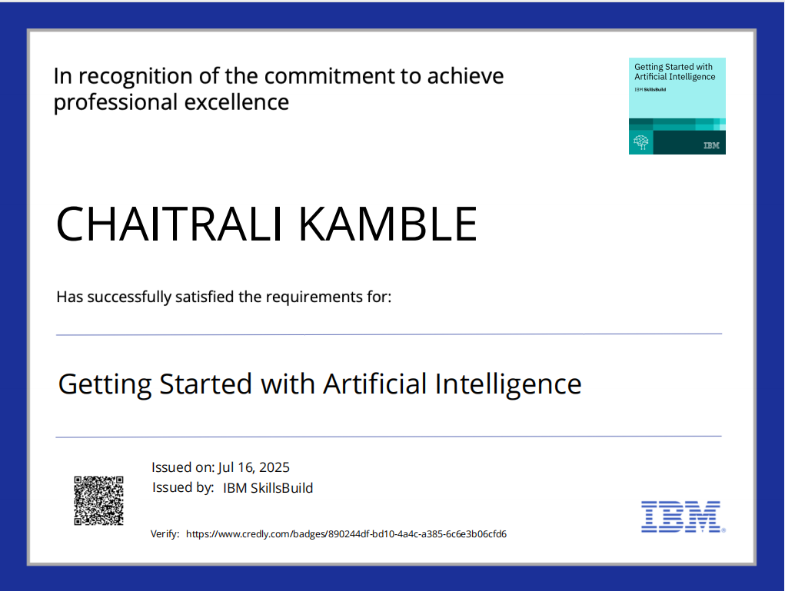
IBM Certifications
Screenshot/ credly certificate( getting started with AI)

Slide 27
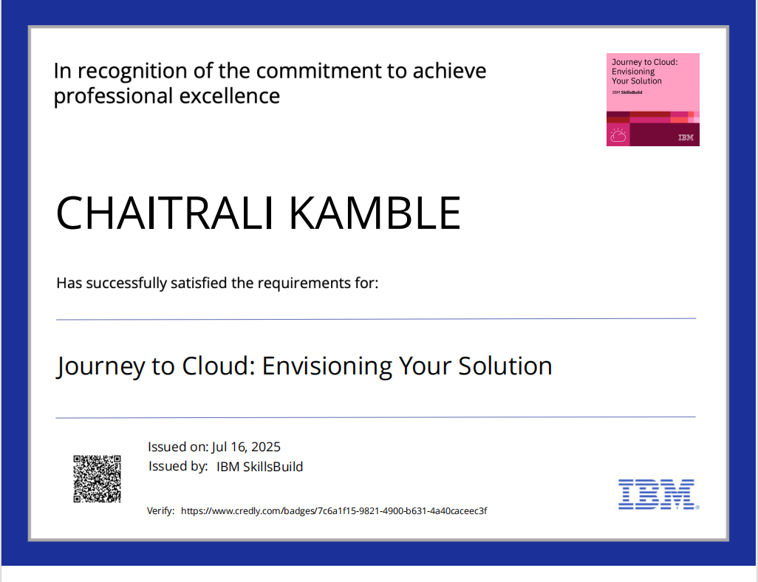
Screenshot/ credly certificate (Journey to Cloud)

Slide 28
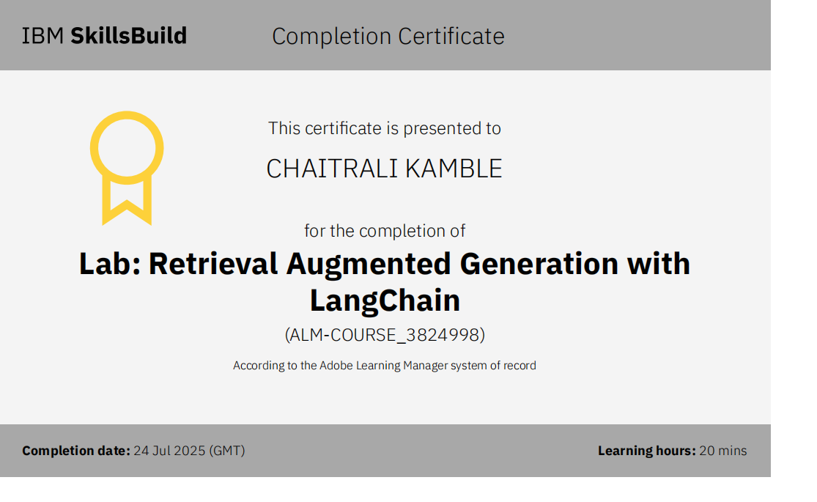
Screenshot/ credly certificate( RAG Lab)

Slide 29
Thank You

